Slide 1
Cars
10/20/15
Michael Motro, Taewan Kim, Rahi Kalantari, Sean Kirmani, Joydeep Ghosh
@ UT Austin

Slide 2
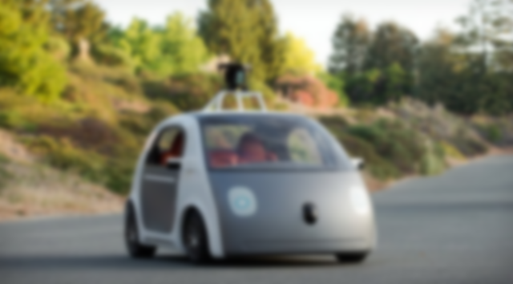

“In June 2015, … 12 accidents as of that date, 8 of which involved being rear-ended at a stop sign or traffic light, 2 in which the vehicle was side-swiped by another driver, 1 of which involved another driver rolling through a stop sign, and 1 where a Google employee was manually driving the car.” – Google monthly reports (Wikipedia summary of)
Autonomous mode: 1,210,676 miles
Manual mode: 911,252 miles

Slide 3
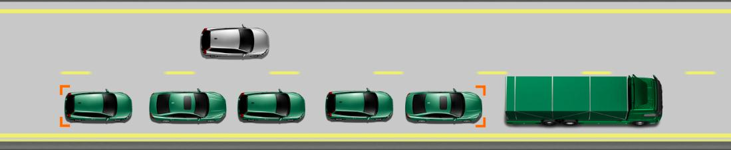
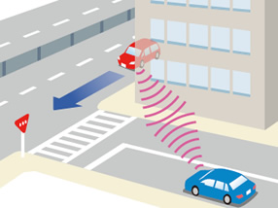
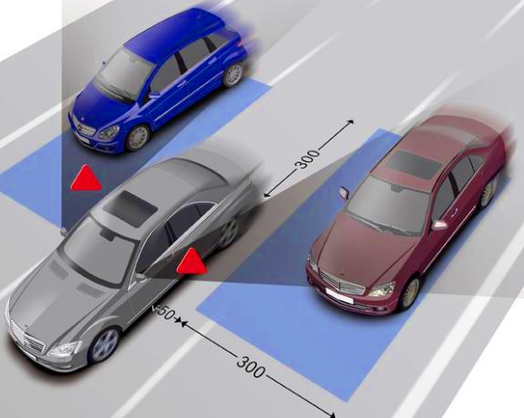
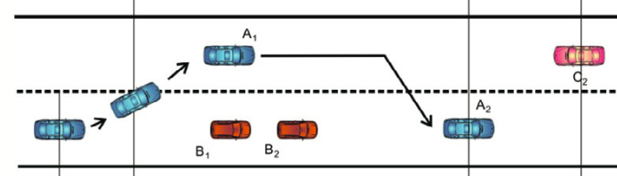
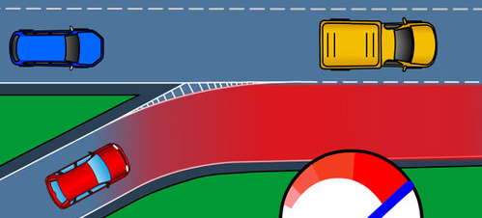
HIGHWAY / RURAL
URBAN
1995
Rear End / Platooning
Intersection - Signs
Lane Change
Intersection - Lights
2015
Overtaking (Rural Road)
Merge
Left Turn w/o Lights

Slide 4
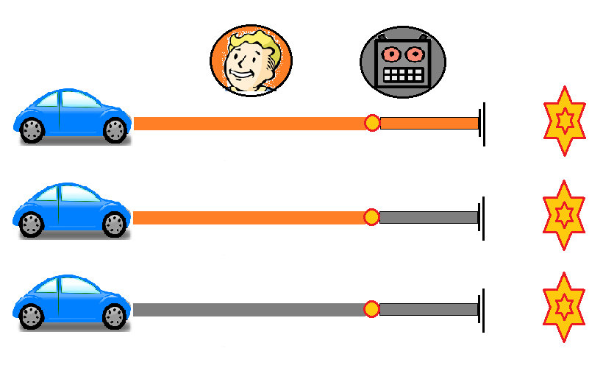
Road Map for Collision Avoidance
Collision Warning
Current State Estimation
Future Trajectory Prediction
Detect Potential Trajectory Conflict
Collision Avoidance
Warning
Takeover
Autonomous
How to use?

Slide 5
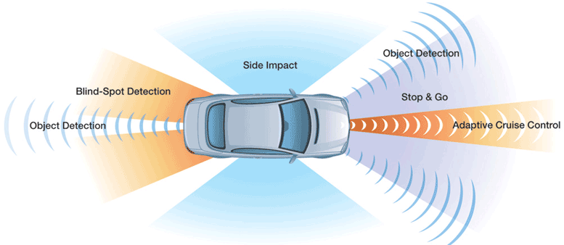

SENSORS
Cameras Radar LIDAR
Problems: Weather
LOS, especially for urban settings
Significant processing/fusion

Slide 6
Communication
DSRC = Dedicated Short Range Communication
Standard, IEEE 802.11p
LOS problem (kind of) solved
Much easier to abstract
Problem:
possible 5G cellular bands
unlicensed spectrum
Automotive radar (24/26 GHz)
Automotive radar (76-81 GHz)
automotive radar
30 GHz
38-49 GHz
60 GHz
unlicensed
70-90 GHz
28 GHz

Slide 7
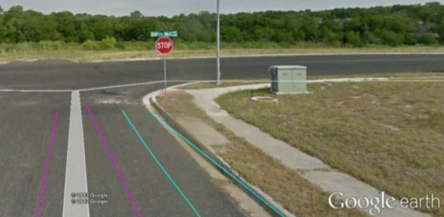
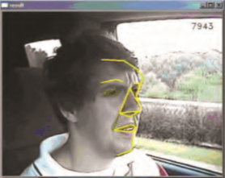


Other Information
Location
Context (Maps, …)
Road Alignment
Driver Interfacing
Infrastructure?

Slide 8


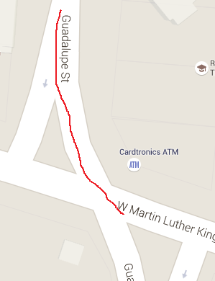
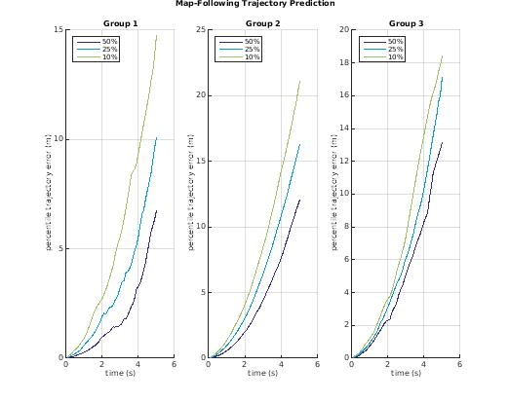
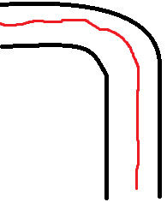
Prediction
“If you choose not to decide, you still have made a choice.”
Time Series Problem: Phase
Context Problem
Time Series Problem 2: Dropoff

Slide 9
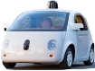
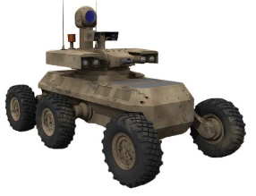
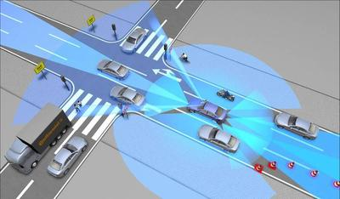
Prediction
Current prototypes?
4
2
3
Context Knowledge
Robotics papers
Transportation papers
0
1
Amount of Training Data
0 = pure physics
1 = predictive model, but one that works in general case (no context)
2 = using context, including scenario-specific areas, but little/no learning component
4 = learning a specific scenario, using data gathered for that scenario

Slide 10
Action
For us:
Warning = assume driver action (perception-reaction time, etc.)
Avoidance = optimization or robotics technique (elastic band, RRT)
Automation = reinforcement learning
Central Intelligence – Peter Stone http://www.cs.utexas.edu/~aim/
Collective Intelligence – nobody yet

Slide 11
break

Slide 12
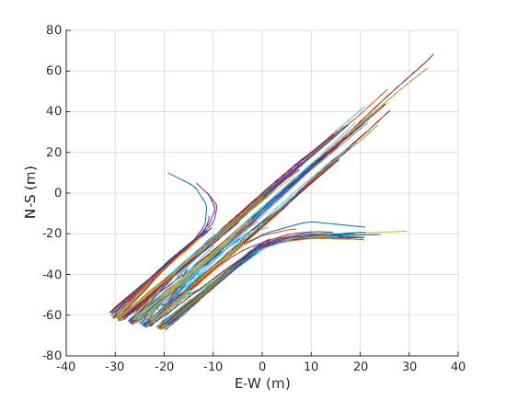
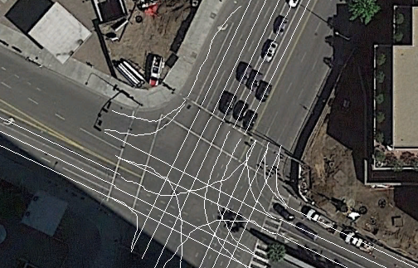
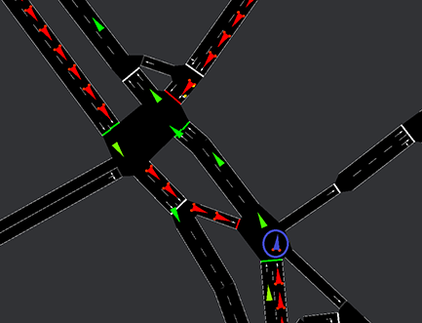
Sims
Real Data
NGSIM
+ Shitty Maps
SUMO

Slide 13
Cheating
5
Lane-specific clusters
Petrich ‘13
4
Barrios ‘11
Hermes ‘09
Dagli ’03*
Aoude ‘12
Map-following
Driver behavior classification at intersections and validation on large naturalistic dataset
2
3
Context Available
Aoude ‘13
RRT
Lai ‘10
Althoff ‘09
No MP
1
0
Blind clusters
Amount of Training Data

Slide 14
Our Trajectory Prediction
Find motion patterns – unsupervised [ex GMM on velocities]
Fit previous trajectory to motion pattern
Combine physics and motion pattern to predict future trajectory [ex Gaussian process]
This still stuck in either 4 (clusters distinguish between lanes) or 2 (cluster on all trajectories at once)
How to get to 3: describe context with features (i.e. # adjacent lanes, curvature, future turns)
Then combine…

Slide 15
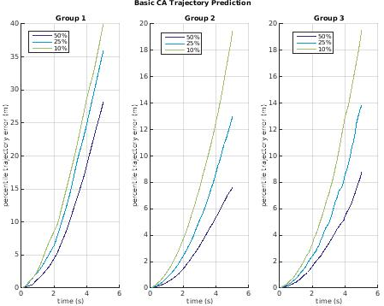
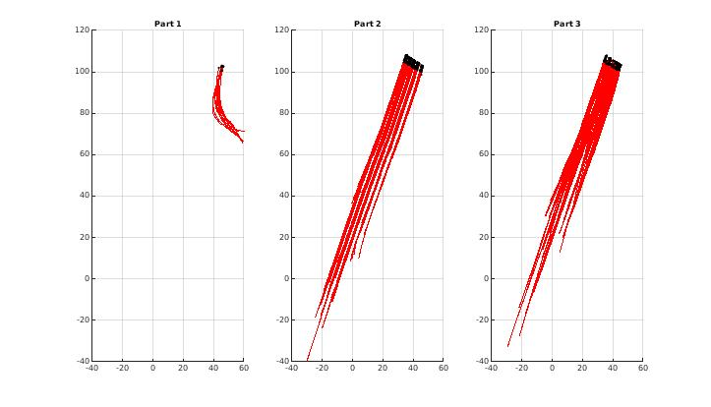
Category 0
Constant Accel. + angular velocity

Slide 16
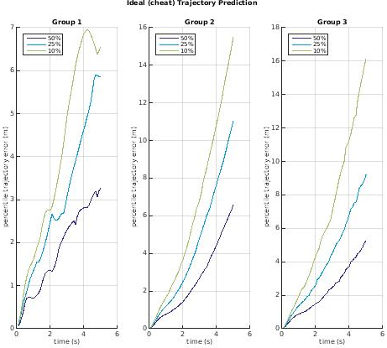
Category 2
Category 5

Slide 17
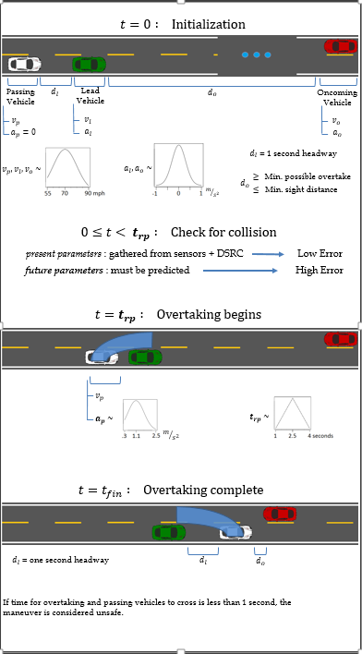
Us - Other
Normal DSRC v.s. mmWave DSRC – what is better for CW/CA?
“ ” v.s. “ ”
Overtake example
How to generalize?

Slide 18
Types of information gathered
Error in Information
Frequency of information updates
Range / completeness of information
Prediction Accuracy over Time
Time needed to avoid collision
Worst-case prediction accuracy
Collision Avoidance Success Rate

Slide 19
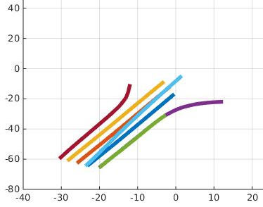
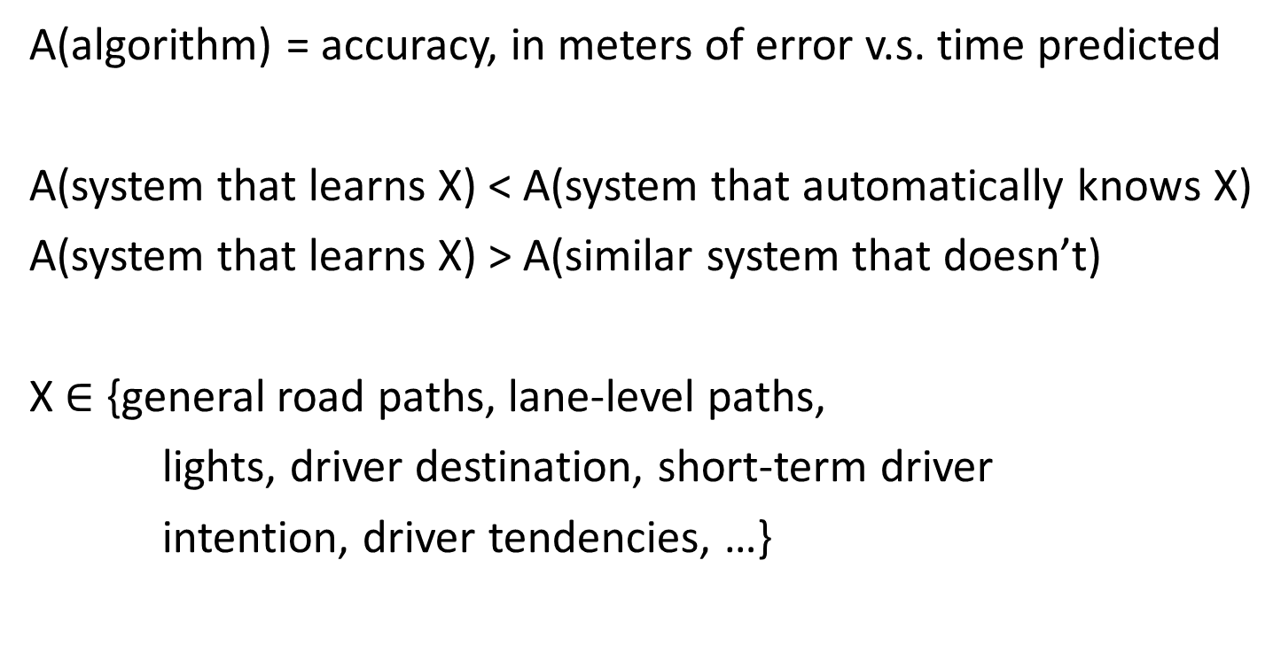
Trajectory Prediction - as generic as possible
A(algorithm) = accuracy, in meters of error v.s. time predicted
A(system that learns X) < A(system that automatically knows X)
A(system that learns X) > A(similar system that doesn’t)
X $∈$ {general road paths, lane-level paths,
lights, driver destination, short-term driver
intention, driver tendencies, …}

Slide 20


Accuracy (meters/second) Accuracy (crashes predicted in time)
Timing simulator
Based on Hillenbrand et al. 08
Accuracy simulator
hardest part
was hoping transportation guys would help….
$$t=−t_{c}$$
$$t=0$$

Slide 21
Us - other
Anomaly Detection
COIN
Other ideas/arguments welcome

